Slide 1
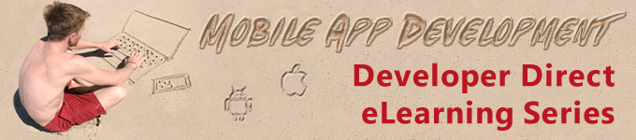
Lesson 1: Hello World My First Multi-Device App
David Intersimone “David I” Vice President of Developer Relations and Chief Evangelist
davidi@embarcadero.com

Slide 2
Mobile App Development
Lesson 1 – Hello World! My First Multi-Device App
Lesson 2 – Turning up the Style and Data!
Lesson 3 – Accessing Local Storage
Lesson 4 – Building Multi-tier, Multi-device Apps
Lesson 5 – Connecting Mobile and Desktop using Tethering
Lesson 6 – Accessing REST and BaaS Cloud Services

Slide 3
Lesson 1 Agenda
Setting up your development environment
The mobile app business scenario
The IDE
Your first app
Samples and Snippets
Get started on the mobile app
Review, Homework and Next Time
Q&A

Slide 4
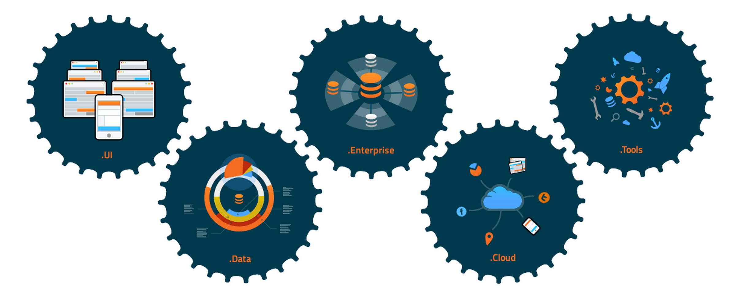
A Complete Application Development Platform
Notes:
UI
A set of extensible components that provide the standard set of controls needed to deliver amazing user experiences. From buttons, to listviews, to tab management, Appmethod provides over 100 cross-platform UI controls with high performance, native look and feel.
DATA
Easily connect to SQL databases, locally on a mobile device or remotely in your Enterprise backend, and convert that data into accessible info in the UI. Live data in the designer provides a rapid prototyping experience. Appmethod also delivers a local embedded database and Enterprise database.
ENTERPRISE
Expose Enterprise data or custom APIs through Appmethod’s turnkey middleware solution. With SOAP or REST/JSON interfaces Appmethod can easily manage client data with caching, in memory dataset management, and delta differencing.
CLOUD
The programmable web is fully available to you in Appmethod. Easily integrate any REST or SOAP based service including MBaaS services such as App42, Kinvey and Parse.
TOOLS
The productivity tools you need to build apps fast: a full-featured IDE, high performance tool chains, integrated remote debuggers and analysis tools. Customer using Appmethod enjoy a 5x faster time to market with the visual design environment.

Slide 5

Developing with Pre-built Components
Developers always have access to platform APIs if and as needed.
Component
Component
Code
iOS
iOS
iOS
iOS
iOS
iOS
iOS
iOS
Android
Android
Android
Android
Android
Android
Android
Android
Windows
Windows
Windows
Windows
Windows
Windows
Windows
Windows
Mac
Mac
Mac
Mac
Mac
Mac
Mac
Mac
APIs

Slide 6
Setting up your Development Environment
Install Appmethod v1.14 or RAD Studio XE6 update 1
Android SDK and NDK are pre-installed and configured
Run the Android SDK manager to make sure you have the latest packages
OSX and iOS
Install Platform Assistant (PAServer) on your Mac and start it
Install the latest Xcode (we leverage the SDKs and command line tools)
Set up OSX and iOS SDKs using Tools | Options
Connection Profile Manager
SDK Manager
Devices
Make sure your Android device is set up for development
Enable USB debugging on your device, install Android USB driver on your PC
Make sure your iOS device is set up for development
Register your device for development

Slide 7
Business Application Scenario
Customer, Orders, Items, Employees, Vendors, Parts
Existing application runs on Windows
Business needs to add mobile apps and extend to the cloud
SQL database is InterBase XE3 “MASTSQL.GDB”
C:\Users\Public\Documents\Embarcadero\Studio\14.0\Samples\Data

Slide 8
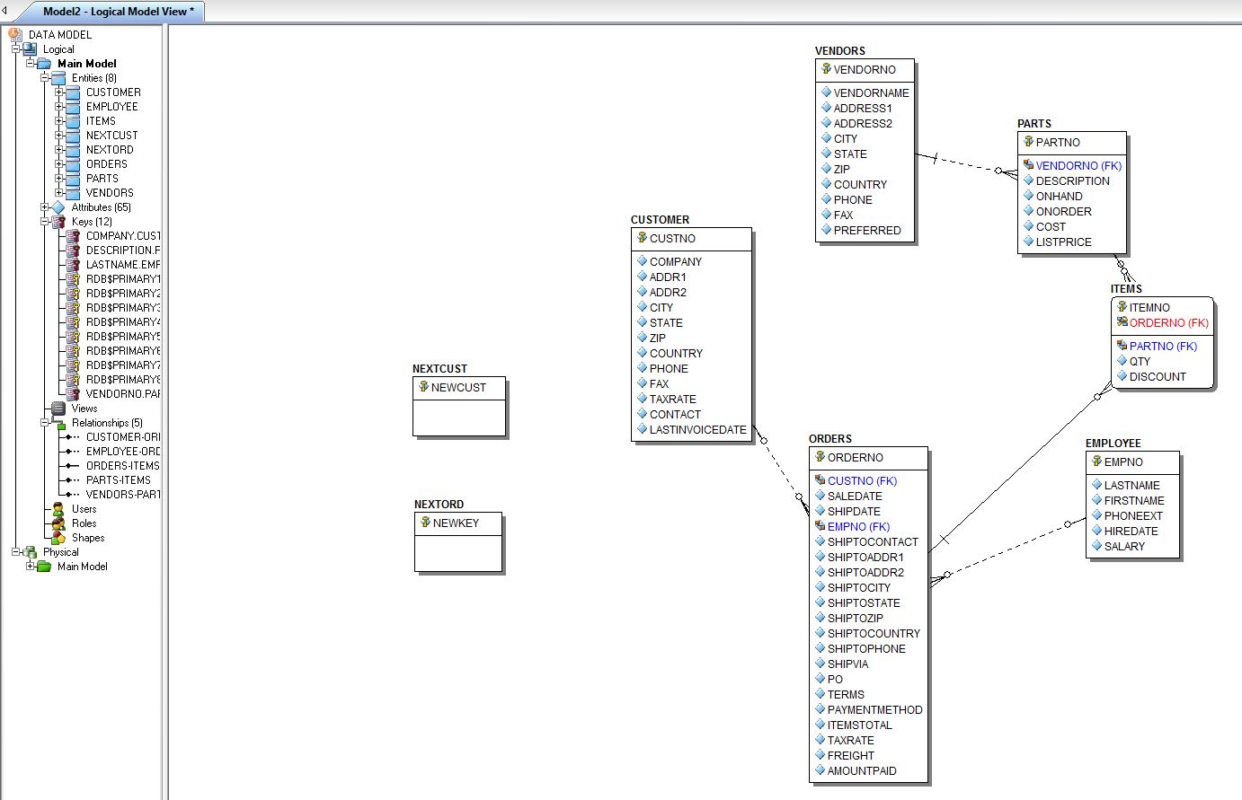
The Data Model

Slide 9
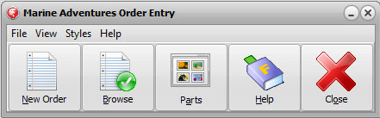
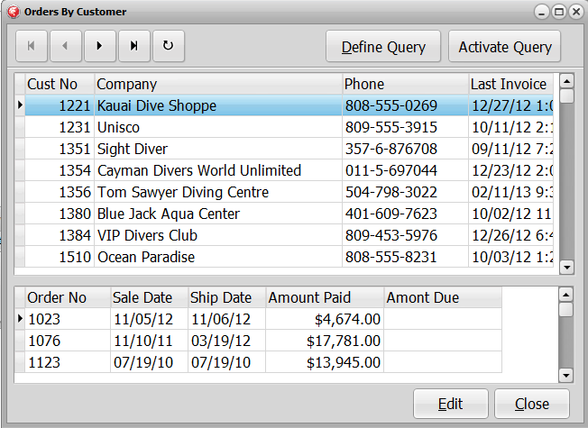
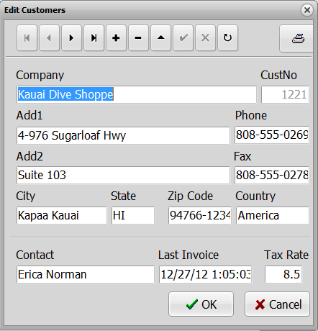
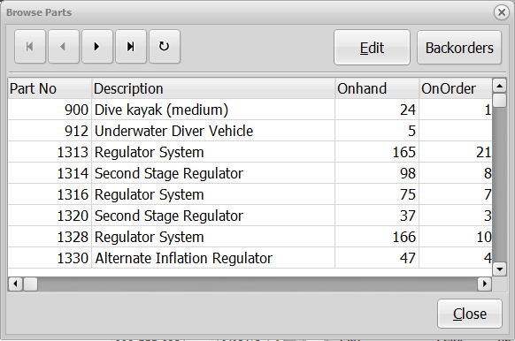
The Existing Windows App
Menu, ButtonBar
Pop-up windows
Edit forms

Slide 10
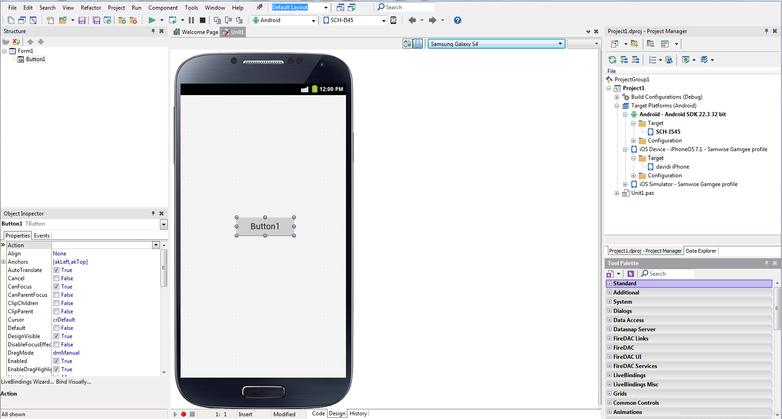
The IDE – menu, toolbar, views
The Structure View shows a tree view that represents the parent-child relationships between the components on the current form. You can use the Structure View to modify these relationships.
The IDE menu provides access to views, projects, commands, debugger and run execution commands. The toolbars provide quick access to frequently used operations and commands.
The Project Manager displays and organizes the contents of your current project group and any project it contains.
Design-time devices are preset forms that give you an idea of the look of your form on a specific device or form factor. The Mobile Designer restricts the design surface to the dimensions of the selected design-time device. Design-time devices do not affect compilation.
The Object Inspector lets you set design-time properties for components you have placed on a form (or for the form itself), create and navigate through event handlers and filter visible properties and events.
The Form Designer is displayed automatically in the center pane when you are using a form. The appearance and functionality of the Designer depends on the type of form you are using. To access the Designer, click the Design tab at the bottom of the IDE.
The Tool Palette contains items (depending on the current view) to help you develop your app. If you are viewing a form in the Designer, it displays components that are appropriate for that form. You can double-click a control to add it to your form. You can also drag it to a desired position on the form. If you are viewing code in the Code Editor, it displays code segments that you can add to your app.
The Code Editor is a full-featured, customizable, UTF8 editor that provides Code Insight, syntax highlighting, multiple undo capability, Smart Block Completion and more. The History Manager lets you compare versions of a file, saved/unsaved local changes, and more. If the current file is under version control, all types of revisions are available.

Slide 11






The Component Framework
ISO C++11
or
Object Pascal
Languages
Framework
Platform API
Win32/64
Cocoa
Cocoa
NDK/SDK
OS
Desktop
Mobile

Slide 12
Develop Apps using Components and Code
A single codebase
Natively compiled apps
iOS and Android native style
Full access to the operating system and the hardware
Component model
Properties
Methods
Events
Visual and Non-Visual components

Slide 13
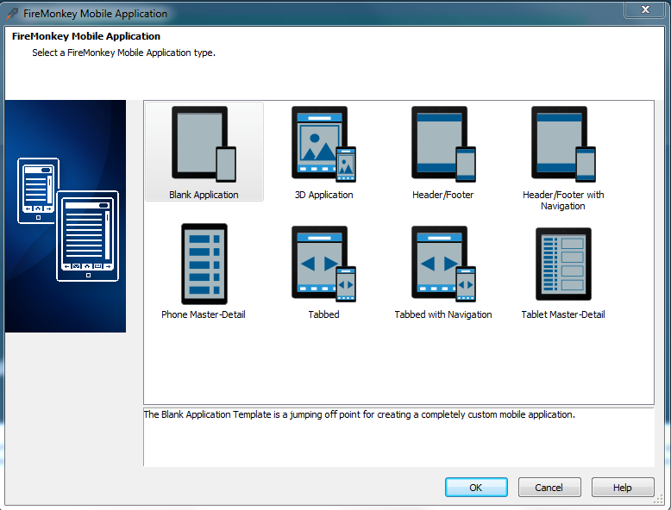
Your First “Hello World” app
File | New | FireMonkey Mobile Application (C++ or Object Pascal)
Application form
Standard UI controls
TabControls
Layouts
Anchors
Alignments
Gestures/Touch
Tools | Options | Form Designer
Device Manager

Slide 14
Samples and Snippets
Mobile Samples
Mobile Snippets
C++ and Object Pascal
Samples are Subversion aware
C:\Users\Public\Documents\Embarcadero\Studio\14.0\Samples
http://sourceforge.net/p/appmethod/code/HEAD/tree/branches/Appmethod_114W/
http://sourceforge.net/p/radstudiodemos/code/HEAD/tree/branches/RadStudio_XE6/

Slide 15
Let’s take a look at some samples
DatePicker
TimePicker
CustomPicker
TabSlideTransition
ScrollableFormDemo

Slide 16
Let’s Get Started on the Business Mobile App
File | New | FireMonkey Mobile Application
Tabbed project template
Decorate the front page and the tabs and tab pages
Toolbar
Tabs
Customers
Employees
Parts
Settings

Slide 17
Lesson 1 Review
Setting up your development environment
Customers, Orders, Parts, Employees business scenario
The IDE
Your first app
Samples and Snippets
Getting started on the mobile app

Slide 18
Resources
Docwiki
http://docwiki.appmethod.com/appmethod/1.14/topics/en/Main_Page
http://docwiki.embarcadero.com/RADStudio/XE6/en/Main_Page
Setting up your development environment
http://docwiki.appmethod.com/appmethod/1.14/topics/en/Mobile_Tutorial:_Set_Up_Your_Development_Environment_on_the_Mac_(iOS)
http://docwiki.appmethod.com/appmethod/1.14/topics/en/Mobile_Tutorial:_Set_Up_Your_Development_Environment_on_Windows_PC_(iOS)
http://docwiki.appmethod.com/appmethod/1.14/topics/en/Mobile_Tutorial:_Set_Up_Your_Development_Environment_on_Windows_PC_(Android)
FireMonkey
http://docwiki.appmethod.com/appmethod/1.14/topics/en/FireMonkey_Platform_Prerequisites
http://docwiki.appmethod.com/appmethod/1.14/topics/en/FireMonkey_Applications_Guide
http://docwiki.appmethod.com/appmethod/1.14/topics/en/FireMonkey_Quick_Start_Guide_-_Introduction
Tutorials
http://docwiki.appmethod.com/appmethod/1.14/topics/en/Tutorial:_Using_the_IDE
http://docwiki.appmethod.com/appmethod/1.14/topics/en/Mobile_Tutorials:_Mobile_Application_Development_(iOS_and_Android)
Blogs
http://blogs.embarcadero.com/
Jim McKeeth - http://delphi.org/
Sarina Dupont - http://blogs.embarcadero.com/sarinadupont/
Note: http://docwiki.appmethod.com/appmethod/1.14/topics/en/... = http://docwiki.embarcadero.com/RADStudio/XE6/en/...

Slide 19
Homework & Next Time
Try out the different project templates
Explore the IDE
Take a look at the samples, snippets and videos
Lesson 2 - Turning up the Style and Data!
Styles
http://docwiki.appmethod.com/appmethod/1.14/topics/en/Customizing_FireMonkey_Applications_with_Styles
TListBox and TListView
http://docwiki.appmethod.com/appmethod/1.14/libraries/en/FMX.ListBox.TListBox
http://docwiki.appmethod.com/appmethod/1.14/libraries/en/FMX.ListView.TListView
LiveBindings
http://docwiki.appmethod.com/appmethod/1.14/topics/en/LiveBindings_in_Appmethod
PrototypeBindSource
http://docwiki.appmethod.com/appmethod/1.14/libraries/en/Data.Bind.ObjectScope.TPrototypeBindSource
Note: http://docwiki.appmethod.com/appmethod/1.14/topics/en/... = http://docwiki.embarcadero.com/RADStudio/XE6/en/...

Slide 20
Q&A

Slide 21
Thank You ☺
davidi@embarcadero.com

